Slide 1
Sets in Python
Understanding Python Collections

Slide 2
What is a Set?
A set is an unordered collection of unique elements in Python.
Sets do not allow duplicates and are mutable.
Syntax :

Slide 3
Characteristics of Sets
Unordered: No indexing or order to elements in a set.
Unique Elements: No duplicates allowed in sets.
Mutable: Elements can be added or removed, but the set itself is unordered and unique.
Heterogeneous: Can contain different data types.

Slide 4


Creating Sets
Note: Duplicates are automatically removed.

Slide 5
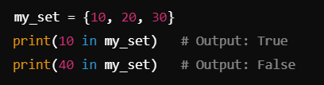
Accessing Set Elements
Since sets are unordered, they don’t support indexing or slicing.

Slide 6
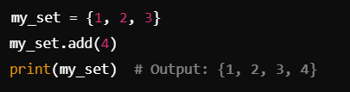
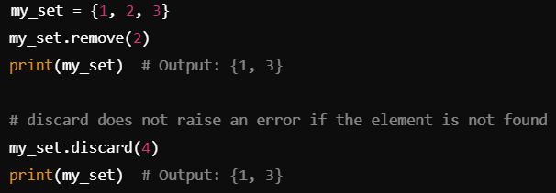
Methods in Python
Removing Elements from a Set
Adding Elements to a Set
Methods: remove() and discard()
Method: add()

Slide 7
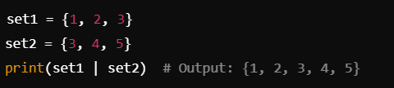



Set Operations
Union: Combines elements from two sets
Intersection: Returns only common elements
Difference: Elements in one set but not in the other
Symmetric Difference: Elements in either set, but not both

Slide 8
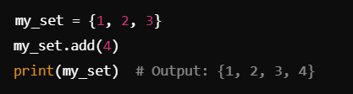
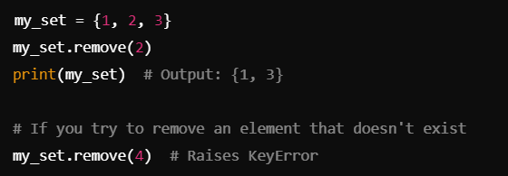
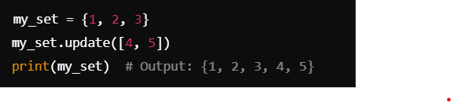
Set Methods
add(): Adds a single element to the set.
update(): Adds multiple elements to the set.
remove(): Removes an element, raises an error if it doesn't exist.

Slide 9
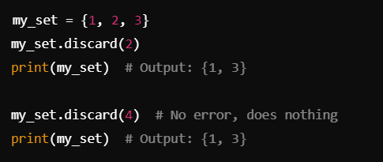
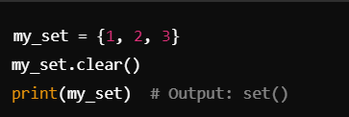
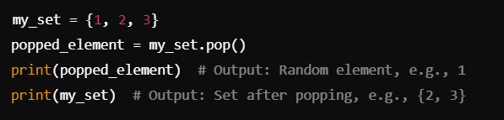
Set Methods
discard(): Removes an element, does not raise an error if it doesn't exist.
pop(): Removes and returns an arbitrary element from the set. Since sets are unordered, you don’t know which element will be popped.
clear(): Removes all elements from the set.

Slide 10
Why Use Sets?
Fast membership testing (in and not in operations).
Automatically removes duplicates.
Useful for mathematical set operations like union and intersection.

Slide 11
THANK YOU
HAPPY LEARNING!

